Slide 1


Convolutional Auto Encoders –Anomaly Detection
INTRODUCTION
OVERVIEW
A type of unsupervised neural network that learns to compress input data into a lower-dimensional latent representation and then reconstructs it.
1.What is a CAE 2.CAE’s architecture and applications 3.Literature Review of reference papers 4.Comparision with other computer vision models/Architecture 5.Pros and Cons of CAE 6.Reseach Gap 7.Objectives 8.Data Description 9.Time Line 10.Conclusion
Used for dimensionality reduction, noise filtering, and—importantly for our case—anomaly detection (by comparing the input and its reconstruction).
B.SURAJ CB.SC.U4AIE24105
C,KARTHIK CB.SC.U4AIE24107
VISHNU TEJA CB.SC.U4AIE24130
I.MOHAN CB.SC.U4AIE24136

Slide 2
Convolutional Auto Encoders –Anomaly Detection
INTRODUCTION
OVERVIEW
A type of unsupervised neural network that learns to compress input data into a lower-dimensional latent representation and then reconstructs it.
1.What is a CAE 2.CAE’s architecture and applications 3.Literature Review of reference papers 4.Comparision with other computer vision models/Architecture 5.Pros and Cons of CAE 6.Reseach Gap 7.Objectives 8.Data Description 9.Time Line 10.Conclusion
Used for dimensionality reduction, noise filtering, and—importantly for our case—anomaly detection (by comparing the input and its reconstruction).
B.SURAJ CB.SC.U4AIE24105
C,KARTHIK CB.SC.U4AIE24107
VISHNU TEJA CB.SC.U4AIE24130
I.MOHAN CB.SC.U4AIE24136

Slide 3
Convolutional Auto Encoders –Anomaly Detection
INTRODUCTION
A type of unsupervised neural network that learns to compress input data into a lower-dimensional latent representation and then reconstructs it.
A specialized autoencoder that uses convolutional layers instead of (or in addition to) fully connected layers.
Its architecture is particularly suited for image data as it efficiently captures spatial hierarchies in images.
CAEs learn to reconstruct “normal” images well; anomalies (which deviate from the learned patterns) tend to have a higher reconstruction error, flagging them as abnormal.
Used for dimensionality reduction, noise filtering, and—importantly for our case—anomaly detection (by comparing the input and its reconstruction).
B.SURAJ CB.SC.U4AIE24105
C,KARTHIK CB.SC.U4AIE24107
VISHNU TEJA CB.SC.U4AIE24130
I.MOHAN CB.SC.U4AIE24136

Slide 4
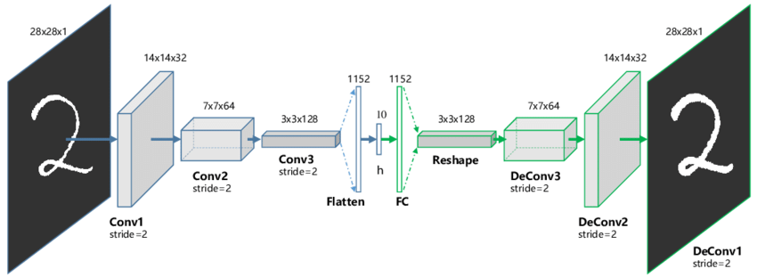
Convolutional Auto Encoders –Anomaly Detection
INTRODUCTION
A type of unsupervised neural network that learns to compress input data into a lower-dimensional latent representation and then reconstructs it.
A specialized autoencoder that uses convolutional layers instead of (or in addition to) fully connected layers.
Its architecture is particularly suited for image data as it efficiently captures spatial hierarchies in images.
CAEs learn to reconstruct “normal” images well; anomalies (which deviate from the learned patterns) tend to have a higher reconstruction error, flagging them as abnormal.
Used for dimensionality reduction, noise filtering, and—importantly for our case—anomaly detection (by comparing the input and its reconstruction).
B.SURAJ CB.SC.U4AIE24105
C,KARTHIK CB.SC.U4AIE24107
VISHNU TEJA CB.SC.U4AIE24130
I.MOHAN CB.SC.U4AIE24136

Slide 5
Convolutional Auto Encoders –Anomaly Detection
INTRODUCTION
A type of unsupervised neural network that learns to compress input data into a lower-dimensional latent representation and then reconstructs it.
A specialized autoencoder that uses convolutional layers instead of (or in addition to) fully connected layers.
Its architecture is particularly suited for image data as it efficiently captures spatial hierarchies in images.
CAEs learn to reconstruct “normal” images well; anomalies (which deviate from the learned patterns) tend to have a higher reconstruction error, flagging them as abnormal.
Used for dimensionality reduction, noise filtering, and—importantly for our case—anomaly detection (by comparing the input and its reconstruction).
B.SURAJ CB.SC.U4AIE24105
C,KARTHIK CB.SC.U4AIE24107
VISHNU TEJA CB.SC.U4AIE24130
I.MOHAN CB.SC.U4AIE24136

Slide 6
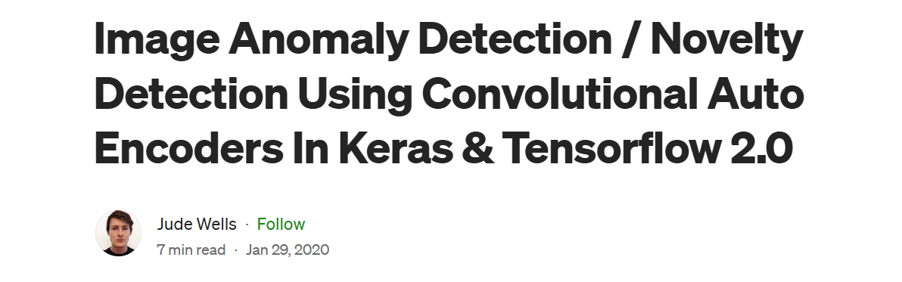
Convolutional Auto Encoders –Anomaly Detection
INTRODUCTION
Utilize a convolutional autoencoder trained exclusively on normal images.
The autoencoder learns to reconstruct these normal images accurately
Anomalies are identified by higher reconstruction errors when the model processes non-normal images.
A specialized autoencoder that uses convolutional layers instead of (or in addition to) fully connected layers.
Its architecture is particularly suited for image data as it efficiently captures spatial hierarchies in images.
CAEs learn to reconstruct “normal” images well; anomalies (which deviate from the learned patterns) tend to have a higher reconstruction error, flagging them as abnormal.

Slide 7
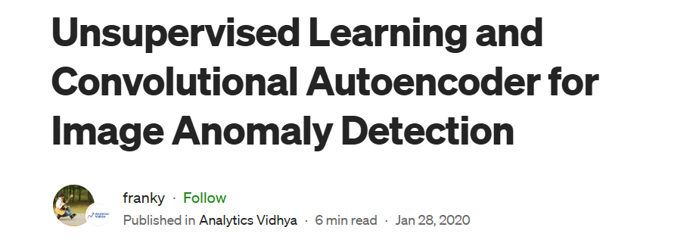
Purpose
Key Strengths
Limitations
YOLO
Utilize a convolutional autoencoder trained exclusively on normal images.
The autoencoder learns to reconstruct these normal images accurately
Anomalies are identified by higher reconstruction errors when the model processes non-normal images.
CAE
Threshold Determination: Setting an optimal reconstruction error threshold to distinguish anomalies from normal variations is non-trivial.
Training Data Quality: Requires a comprehensive dataset of "normal" images; gaps in training data can lead to poor generalization.
Model Complexity: Balancing autoencoder depth and computational efficiency while avoiding overfitting to normal patterns.
GAN
Object detection in real-time
Data generation and unsupervised leaning
Reconstruction-based anomaly detection

Slide 8
Purpose
Key Strengths
Limitations
YOLO
Utilize a convolutional autoencoder trained exclusively on normal images.
The autoencoder learns to reconstruct these normal images accurately
Anomalies are identified by higher reconstruction errors when the model processes non-normal images.
CAE
Threshold Determination: Setting an optimal reconstruction error threshold to distinguish anomalies from normal variations is non-trivial.
Training Data Quality: Requires a comprehensive dataset of "normal" images; gaps in training data can lead to poor generalization.
Model Complexity: Balancing autoencoder depth and computational efficiency while avoiding overfitting to normal patterns.
GAN
Object detection in real-time
Data generation and unsupervised leaning
Reconstruction-based anomaly detection

Slide 9
Purpose
Key Strengths
Limitations
YOLO
Utilize a convolutional autoencoder trained exclusively on normal images.
The autoencoder learns to reconstruct these normal images accurately
Anomalies are identified by higher reconstruction errors when the model processes non-normal images.
GAN
CAE
Object detection in real-time
Data generation and unsupervised leaning
Reconstruction-based anomaly detection

Slide 10
Purpose
Key Strengths
Limitations
YOLO
Object detection in real-time
Utilize a convolutional autoencoder trained exclusively on normal images.
The autoencoder learns to reconstruct these normal images accurately
Anomalies are identified by higher reconstruction errors when the model processes non-normal images.
GAN
Data generation and unsupervised leaning
Reconstruction-based anomaly detection
CAE
Fast, excellent for real-time detection
Can generate highly realistic images; robust anomaly detection with specialized architectures
Simple architecture; effective with image data; unsupervised training

Slide 11
Purpose
Key Strengths
Limitations
Fast, excellent for real-time detection
YOLO
Object detection in real-time
Can generate highly realistic images; robust anomaly detection with specialized architectures
GAN
Data generation and unsupervised leaning
Simple architecture; effective with image data; unsupervised training
CAE
Primarily supervised; not tailored for unsupervised anomaly detection
Reconstruction-based anomaly detection
Training can be unstable and computationally intensive
May not capture global context as well as some advanced models; hyperparameter tuning required

Slide 12
Fast, excellent for real-time detection
Can generate highly realistic images; robust anomaly detection with specialized architectures
Purpose
Key Strengths
Limitations
Simplicity
Limited Global Feature Capture
YOLO
Primarily supervised; not tailored for unsupervised anomaly detection
Efficiency
Hyperparameter Sensitivity
Training can be unstable and computationally intensive
GAN
Unsupervised Learning
May not capture global context as well as some advanced models; hyperparameter tuning required
Reconstruction Quality
CAE
Interpretability
Simple architecture; effective with image data; unsupervised training

Slide 13
Fast, excellent for real-time detection
Can generate highly realistic images; robust anomaly detection with specialized architectures
Purpose
YOLO
Key Strengths
Limitations
Simplicity
Limited Global Feature Capture
Primarily supervised; not tailored for unsupervised anomaly detection
Efficiency
Training can be unstable and computationally intensive
Hyperparameter Sensitivity
GAN
Unsupervised Learning
Reconstruction Quality
Interpretability
May not capture global context as well as some advanced models; hyperparameter tuning required
CAE
Simple architecture; effective with image data; unsupervised training

Slide 14
Fast, excellent for real-time detection
Can generate highly realistic images; robust anomaly detection with specialized architectures
Research Gap
Purpose
YOLO
Key Strengths
Limitations
Simplicity
Limited Global Feature Capture
Primarily supervised; not tailored for unsupervised anomaly detection
Current Challenge: While advanced CAE architectures exist, they can be too complex for practical, small-scale deployment.
The Gap: There is a need for a streamlined CAE model that balances performance and simplicity.
State-of-the-Art: Research is catching up to develop architectures that are both high-performing and easy to implement without extensive computational resources.
Efficiency
Hyperparameter Sensitivity
Training can be unstable and computationally intensive
GAN
Unsupervised Learning
Reconstruction Quality
Interpretability
May not capture global context as well as some advanced models; hyperparameter tuning required
CAE
Simple architecture; effective with image data; unsupervised training

Slide 15
Limited Global Feature Capture
Fast, excellent for real-time detection
Simplicity
Can generate highly realistic images; robust anomaly detection with specialized architectures
Research Gap
Efficiency
Purpose
YOLO
Key Strengths
Limitations
Primarily supervised; not tailored for unsupervised anomaly detection
Current Challenge: While advanced CAE architectures exist, they can be too complex for practical, small-scale deployment.
The Gap: There is a need for a streamlined CAE model that balances performance and simplicity.
State-of-the-Art: Research is catching up to develop architectures that are both high-performing and easy to implement without extensive computational resources.
Training can be unstable and computationally intensive
Hyperparameter Sensitivity
GAN
Unsupervised Learning
May not capture global context as well as some advanced models; hyperparameter tuning required
CAE
Reconstruction Quality
Interpretability
Simple architecture; effective with image data; unsupervised training

Slide 16



Limited Global Feature Capture
Simplicity
Efficiency
Objective
Research Gap
Easy to Train
Current Challenge: While advanced CAE architectures exist, they can be too complex for practical, small-scale deployment.
The Gap: There is a need for a streamlined CAE model that balances performance and simplicity.
State-of-the-Art: Research is catching up to develop architectures that are both high-performing and easy to implement without extensive computational resources.
Hyperparameter Sensitivity
Simple to Implement
Achieve higher accuracy
Unsupervised Learning
Reconstruction Quality
Interpretability

Slide 17
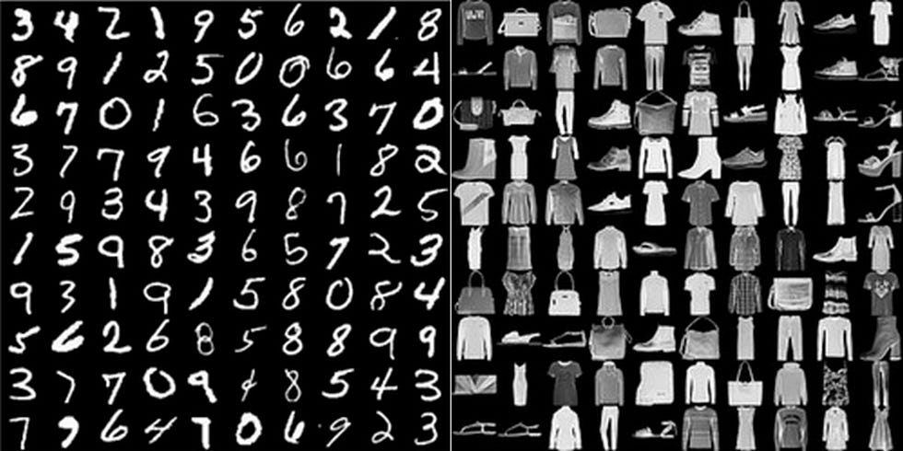
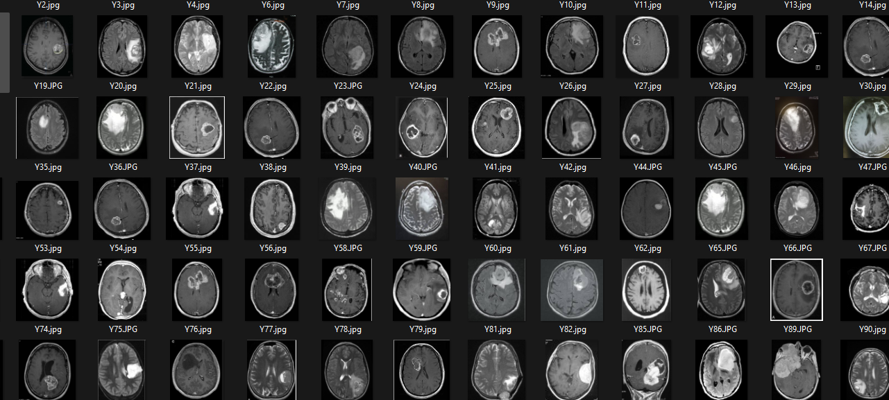
Dataset Description
Objective
Research Gap
MNIST Dataset
Brain Imaging Dataset
Easy to Train
Simple to Implement
Achieve higher accuracy
Current Challenge: While advanced CAE architectures exist, they can be too complex for practical, small-scale deployment.
The Gap: There is a need for a streamlined CAE model that balances performance and simplicity.
State-of-the-Art: Research is catching up to develop architectures that are both high-performing and easy to implement without extensive computational resources.

Slide 18
TIMELINE
Objective
Dataset Description
Research Gap
MNIST Dataset
Brain Imaging Dataset
Easy to Train
Month end or March 1st week
Simple to Implement
Today
Achieve higher accuracy

Slide 19
Dataset Description
Objective
TIMELINE
Research Gap
CONCLUSION
MNIST Dataset
Brain Imaging Dataset
Today
Convolutional Autoencoders (CAEs) offer a simple yet powerful method for anomaly detection, outperforming more complex models like YOLO and GANs in ease of use and scalability. Our goal is to enhance CAE accuracy with techniques like denoising while making it practical for small businesses. This approach bridges research gaps and simplifies real-world applications, with future work focused on refining our methodology and optimizing performance.
Month end or March 1st week
Easy to Train
Simple to Implement
Achieve higher accuracy

Slide 20
Dataset Description
TIMELINE
Objective
Research Gap
CONCLUSION
MNIST Dataset
Brain Imaging Dataset
Convolutional Autoencoders (CAEs) offer a simple yet powerful method for anomaly detection, outperforming more complex models like YOLO and GANs in ease of use and scalability. Our goal is to enhance CAE accuracy with techniques like denoising while making it practical for small businesses. This approach bridges research gaps and simplifies real-world applications, with future work focused on refining our methodology and optimizing performance.
Today
Month end or March 1st week
Easy to Train
THANK YOU
Simple to Implement
Achieve higher accuracy

Slide 21
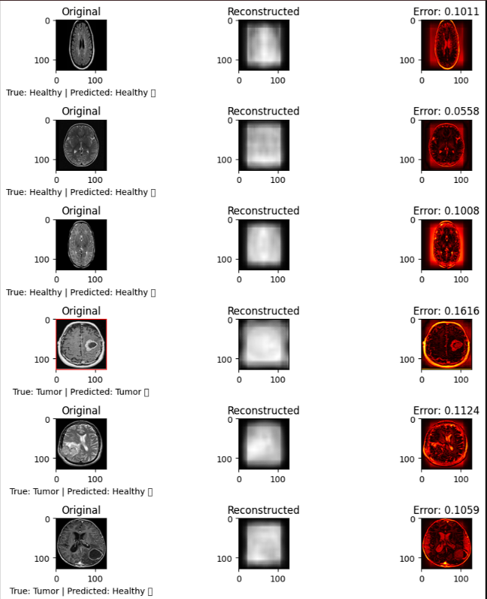
CONCLUSION
Convolutional Autoencoders (CAEs) offer a simple yet powerful method for anomaly detection, outperforming more complex models like YOLO and GANs in ease of use and scalability. Our goal is to enhance CAE accuracy with techniques like denoising while making it practical for small businesses. This approach bridges research gaps and simplifies real-world applications, with future work focused on refining our methodology and optimizing performance.
Dataset Description
TIMELINE
Objective
Research Gap
MNIST Dataset
Brain Imaging Dataset
THANK YOU
Today
Month end or March 1st week
Easy to Train
Simple to Implement
Achieve higher accuracy

Slide 22
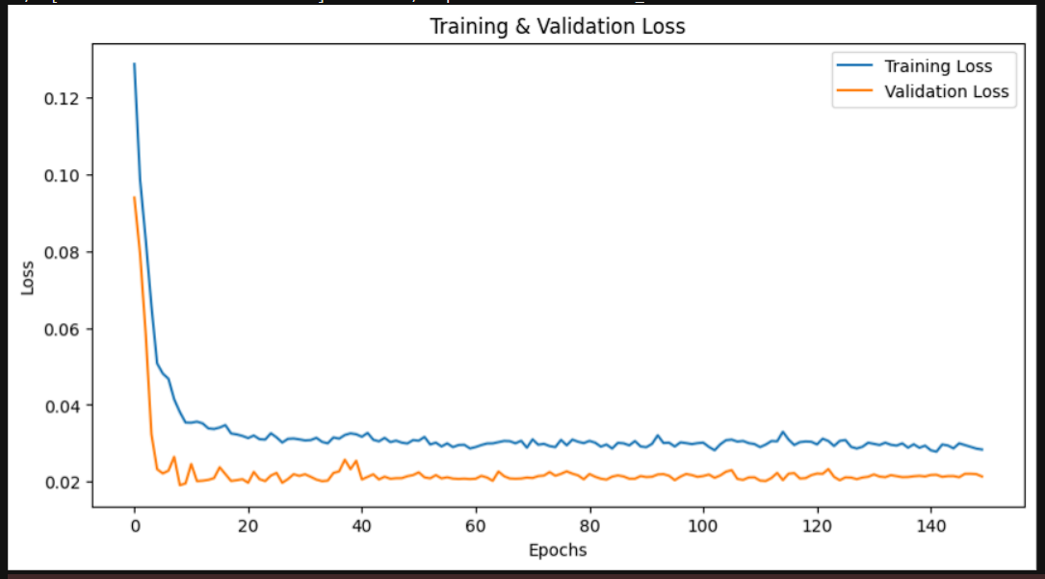
CONCLUSION
Convolutional Autoencoders (CAEs) offer a simple yet powerful method for anomaly detection, outperforming more complex models like YOLO and GANs in ease of use and scalability. Our goal is to enhance CAE accuracy with techniques like denoising while making it practical for small businesses. This approach bridges research gaps and simplifies real-world applications, with future work focused on refining our methodology and optimizing performance.
Dataset Description
TIMELINE
Objective
Research Gap
MNIST Dataset
Brain Imaging Dataset
Today
THANK YOU
Month end or March 1st week
Easy to Train
Simple to Implement
Achieve higher accuracy

Slide 23
CONCLUSION
Convolutional Autoencoders (CAEs) offer a simple yet powerful method for anomaly detection, outperforming more complex models like YOLO and GANs in ease of use and scalability. Our goal is to enhance CAE accuracy with techniques like denoising while making it practical for small businesses. This approach bridges research gaps and simplifies real-world applications, with future work focused on refining our methodology and optimizing performance.
Dataset Description
TIMELINE
Objective
Research Gap
MNIST Dataset
Brain Imaging Dataset
Today
THANK YOU
Month end or March 1st week
Easy to Train
Simple to Implement
Achieve higher accuracy

